Slide 1
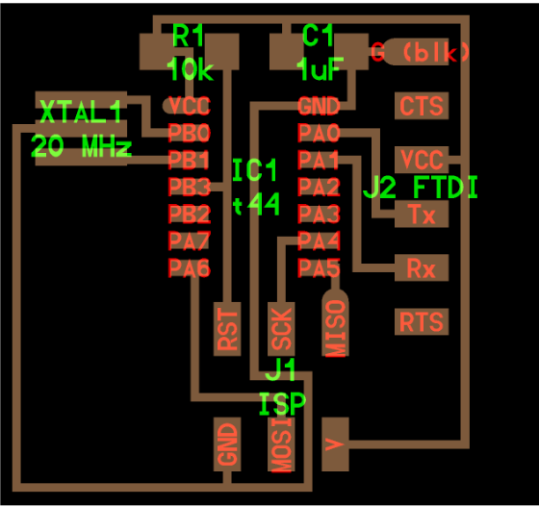
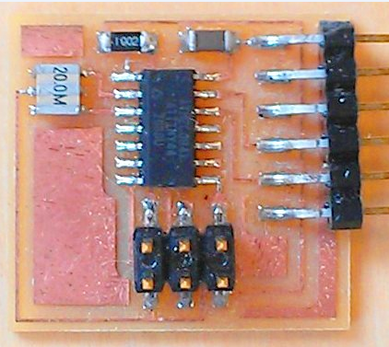

Slide 2
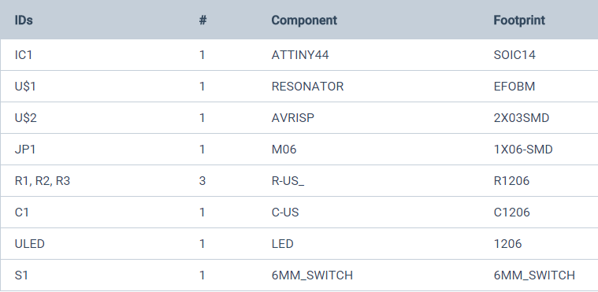
R1
10K
C1
1uF
IC1
t44
XTAL1
20 Mhz
J1
ISP
J2
FTDI

Slide 3
