Slide 1
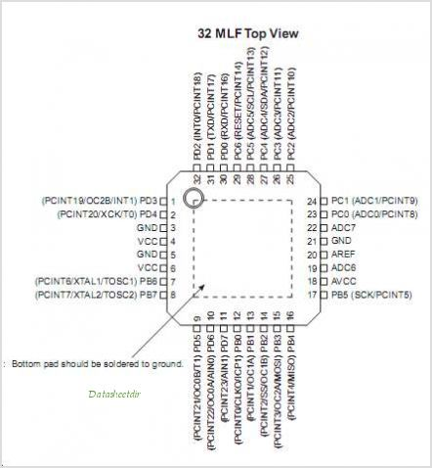

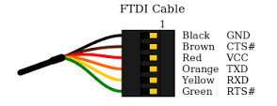
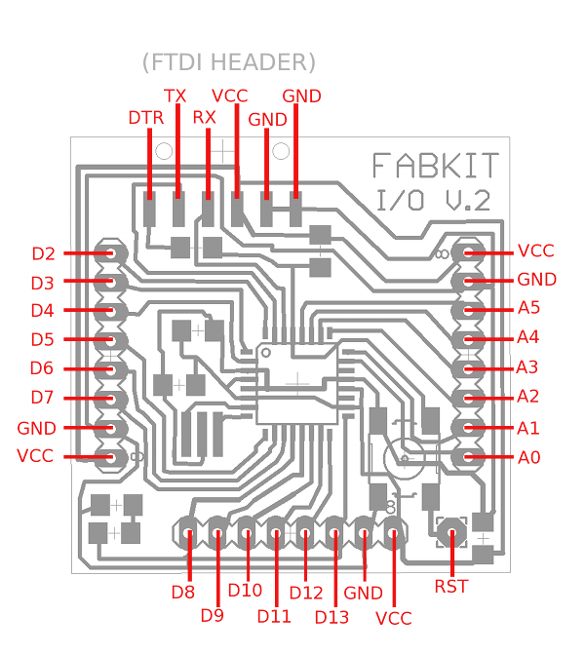
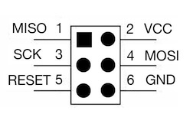
ATMEGA328P
Pinout
Reference

Slide 2
FabKIT 0.2
ATMEGA328P
Pin Mapping
digital pin 2
digital pin 1 (TX)
digital pin 0 (RX)
reset
analog input 5
analog input 4
analog input 3
analog input 2
digital pin 3 (PWM)
analog input 1
digital pin 4
analog input 0
GND
GND
VCC
analog reference
GND
VCC
crystal
crystal
digital pin 13
digital pin 5 (PWM)
digital pin 6 (PWM)
digital pin 7
digital pin 8
digital pin 9 (PWM)
digital pin 10 (PWM)
digital pin 11 (PWM)
digital pin 12 (MISO)

Slide 3
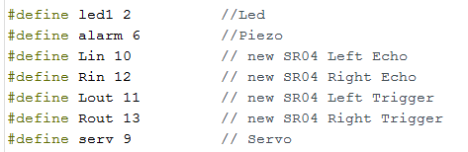

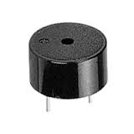
Project
Pinout
Connect the long leg of the LED (the positive leg, called the anode) to the other end of the resistor. Connect the short leg of the LED (the negative leg, called the cathode) to the Arduino GND,
+ Cathode
+ Anode
+ Cathode
+ Anode
+ Cathode
+ Anode
+ Cathode
+ Anode
Piezo
GND

